Slide 1

Course: Digital Image Processing
By: Dr. Muhammad Fayaz
Department of Computer Science, University of Central Asia

Slide 2
RECAP
What is an Image?
Representation of an Image
Types of Images
Binary Image
Grayscale Image
RGB Image
Image Sampling and Quantization
Spatial Resolution
Libraries
Relationship Between Pixels
Neighborhoods: N₄, N_{D}, and N₈
Adjacency: N₄, and N_{8 ,} and Mix-adjacency
Distances: N₄ (City Block Distance), and N₈ (Chess Board Distance)
Region, Boundary, and Edge
Types of Image Enhancement Operations
Min-Max Marching
Histogram Equalization
Histogram Matching
Image matching
Image Restoration
Convolution
Noise
Padding

Slide 3
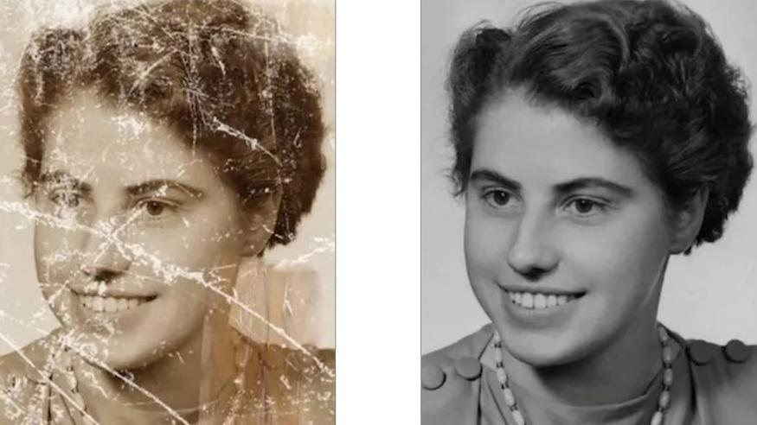
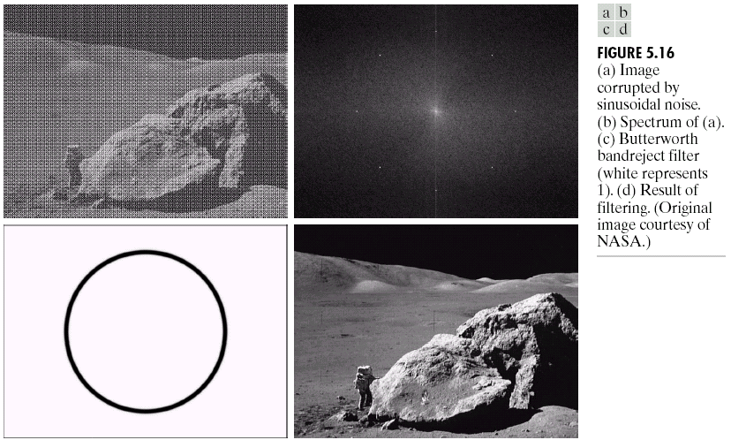
Image Restoration
Image Restoration
Morphological Processing
Image Enhancement
Segmentation
Image Acquisition
Object Recognition
Representation & Description
Problem Domain
Colour Image Processing
Image Compression

Slide 4
Assignment

Slide 5
Noise Reduction
Noise reduction refers to the various methods and techniques used to enhance the quality of digital images by reducing unwanted noise while preserving important image features.
Spatial Filters
Linear Filter
Mean/Box Filters
Weighted Average
Median Filter
Max Filter
Min Filter
Non-Linear Filter/
Order Statistics Filters
Low Pass Filters
High Pass Filters
The Laplacian Filter
Smoothing Filters

Slide 6
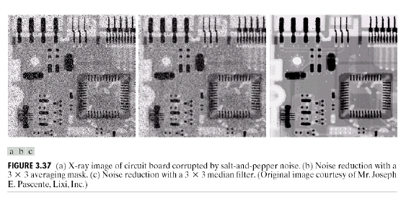
Median Filtering (Example)

Slide 7
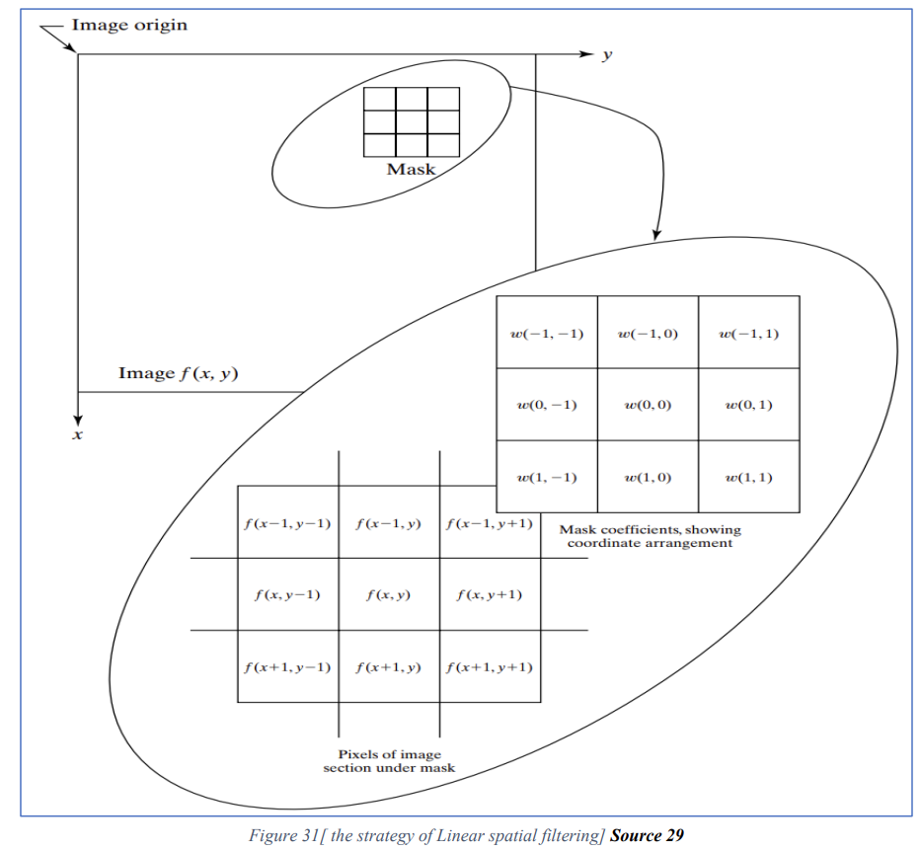
Spatial Filtering
Linear Filters: Operation consists of multiplying each pixel in the mask by corresponding element in the neighborhood, and adding up all these products.

Slide 8
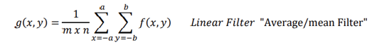
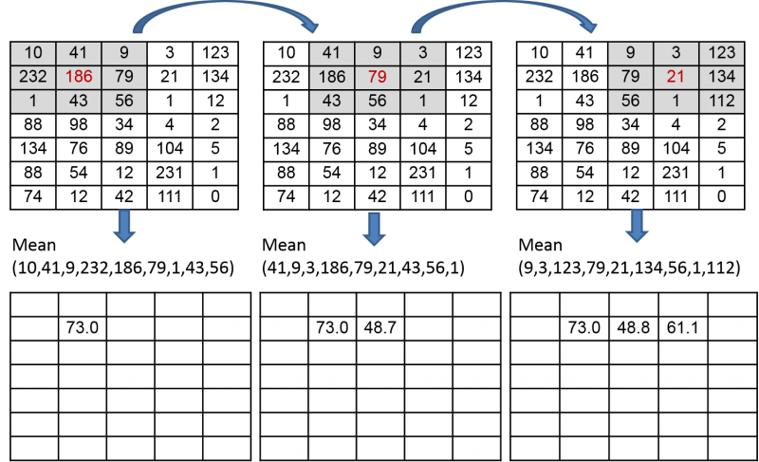
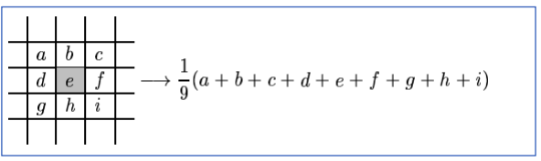
Mean/Averaging Filter
Average (or mean): filtering is a method of 'smoothing' images by reducing the amount of intensity variation between neighboring pixels.
The average filter works by moving through the image pixel by pixel, replacing each value with the average value of neighboring pixels, including itself.

Slide 9
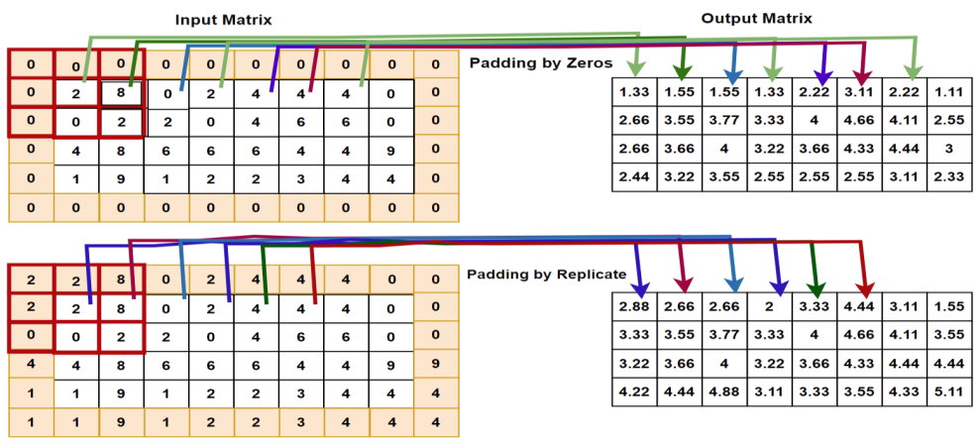
Mean/Averaging Filter

Slide 10
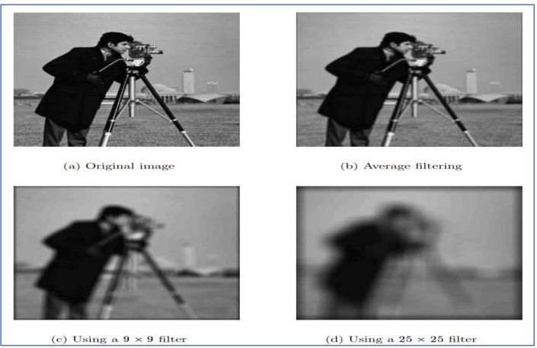
Mean/Averaging Filter

Slide 11
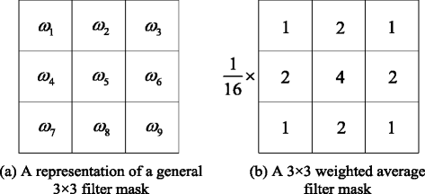
Weighted Average Filter
In weighted average filter, we gave more weight to the centre value, due to which the contribution of centre becomes more than the rest of values.
Due to the weighted average filtering, we can control the blurring of image.

Slide 12
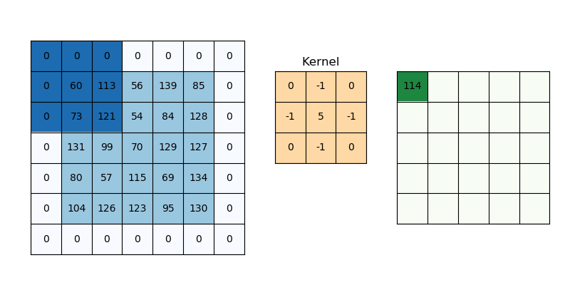
Weighted Average Filter

Slide 13
Spatial Filtering
Non-Linear Filters: The non-linear spatial filters are based on linear operations such as taking the maximum element in the mask in max filter, or taking the minimum element in the min filter or taking the median element in the median filter.

Slide 14
Median Filter
A median filter is a common noise reduction technique used in image processing to reduce impulsive noise, such as salt-and-pepper noise, from digital images.
It works by replacing the value of a pixel with the median value of its neighbouring pixels within a defined window or kernel.
The median is the middle value in a sorted list of numbers, making it effective at removing outliers or extreme values that could be caused by noise.
Here's how a median filter works:
Sliding Window: The filter slides through the entire image, cantered on each pixel. The size of the window or kernel is defined by the user and determines the area over which the median is calculated.
Neighborhood Pixel Values: The pixel values within the window are collected and sorted in ascending order.
Median Calculation: The median value (middle value) of the sorted pixel values is then selected as the new value for the center pixel being processed.

Slide 15
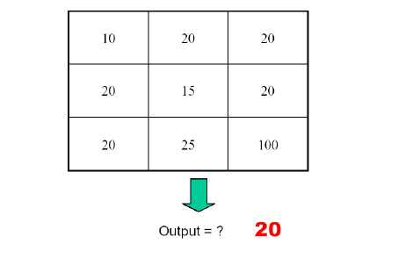
Median Filtering

Slide 16
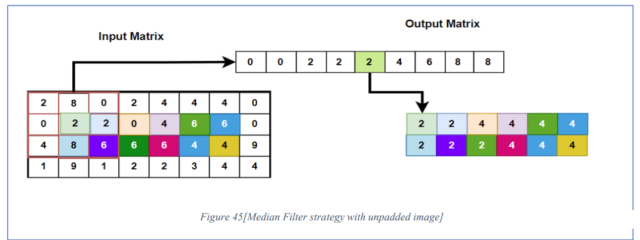
Median Filter
Median Filter with unpadded image

Slide 17
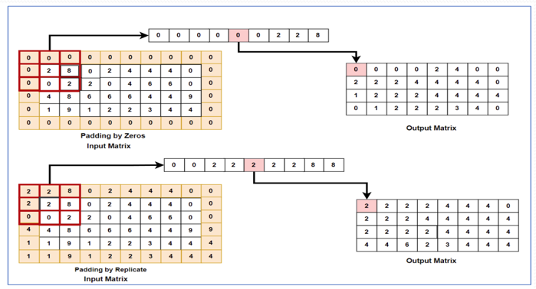
Median Filter
Median Filter with padded image

Slide 18
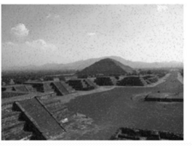
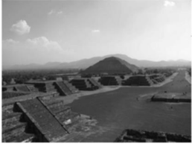
Median Filter
Median Filter with unpadded image

Slide 19
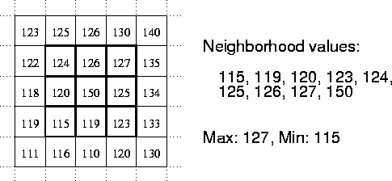
Min Filter

Slide 20
Max Filter

Slide 21
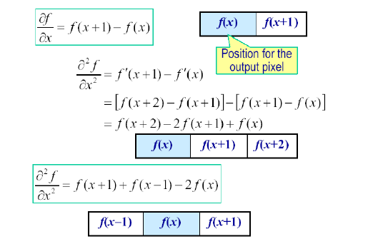
First and Second Order Derivatives

Slide 22
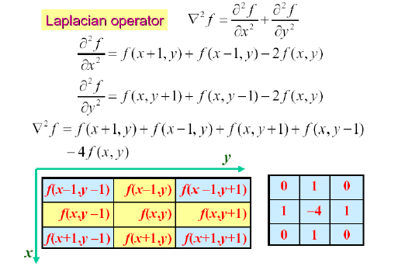
Laplacian for Image Enhancement

Slide 23
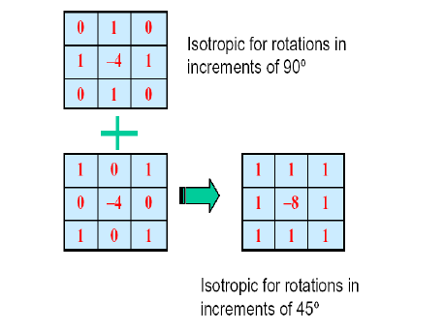
Laplacian for Image Enhancement

Slide 24
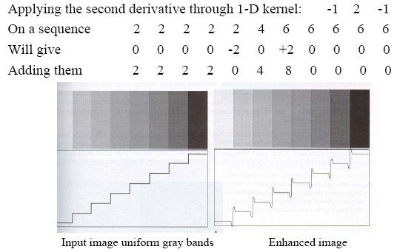
Enhancement by 2nd Derivative (Example)

Slide 25
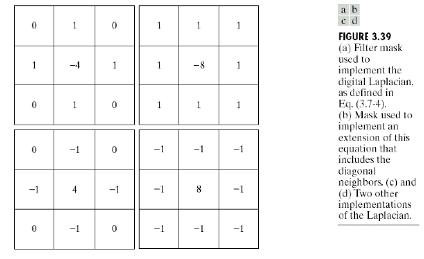
Laplacian for Image Enhancement

Slide 26
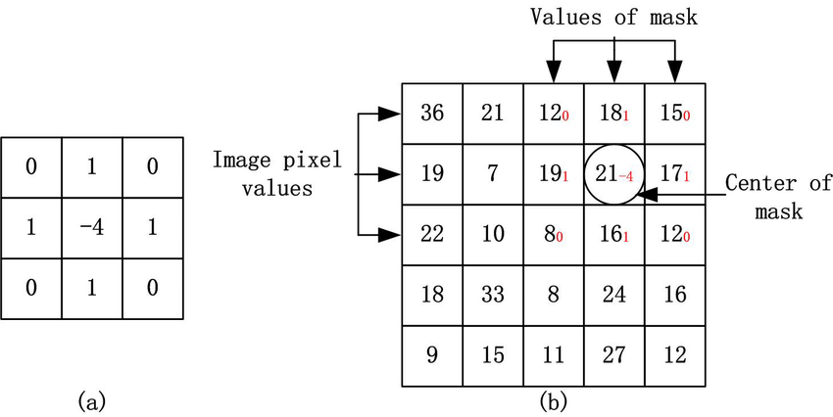
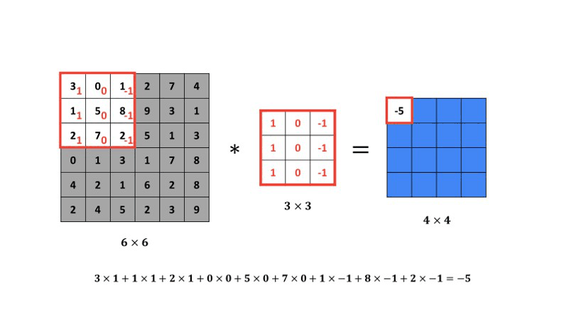
Laplacian for Image Enhancement

Slide 27
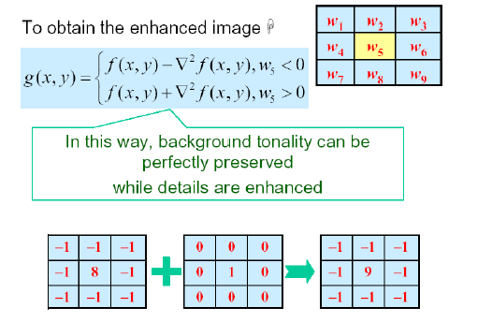
Laplacian for Image Enhancement

Slide 28
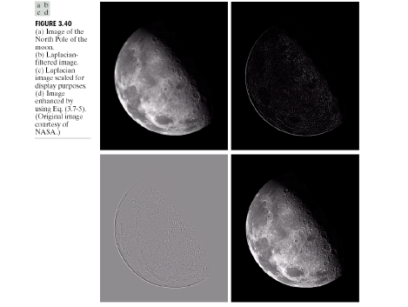
Laplacian for Image Enhancement (Example)

Slide 29
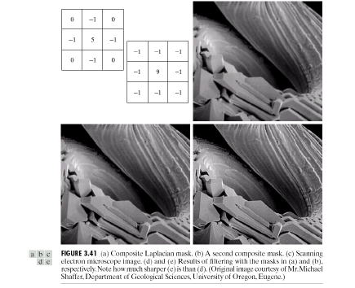
Laplacian for Image Enhancement (Example)

Slide 30
IMAGE RESIZING

Slide 31
Image Resizing
Image resizing techniques in image processing are used to change the dimensions of an image while preserving its visual content and aspect ratio.
Resizing is commonly required to adapt images for various display or processing purposes.
Here are some commonly used image resizing techniques:
Nearest-Neighbor Interpolation
Bilinear Interpolation

Slide 32
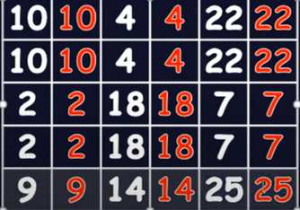
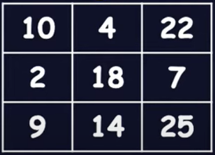
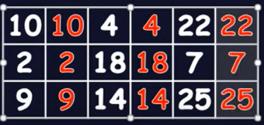
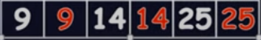
Nearest-Neighbor Interpolation
Nearest-neighbor interpolation is a simple image resizing technique used in computer graphics and image processing.
It involves determining the value of a new pixel in a resized image by selecting the value of the nearest pixel from the original image.
This method is straightforward but can lead to blocky and jagged artifacts, especially when reducing the image size.
Duplicate Columns
Duplicate Rows
Duplicate Columns
Duplicate Rows

Slide 33
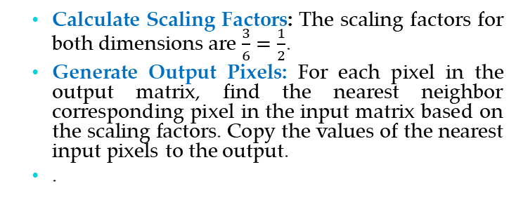
Nearest-Neighbor Interpolation
Let’s calculate the values of each output pixels
Output pixel at (1,1): Corresponding input pixel: (1,1) in the input matrix. Value: 10
Output pixel at (1,2): Corresponding input pixel: (1,3) in the input matrix. Value: 4
Output pixel at (1,3): Corresponding input pixel: (1,5) in the input matrix. Value: 22
Output pixel at (2,1): Corresponding input pixel: (3,1) in the input matrix. Value: 2
Output pixel at (2,2): Corresponding input pixel: (3,3) in the input matrix. Value: 18
Output pixel at (2,3): Corresponding input pixel: (3,5) in the input matrix. Value: 7
Output pixel at (3,1): Corresponding input pixel: (5,1) in the input matrix. Value: 9
Output pixel at (3,2): Corresponding input pixel: (5,3) in the input matrix. Value: 14
Output pixel at (3,3): Corresponding input pixel: (5,5) in the input matrix. Value: 2
Nearest-neighbour interpolation
10 | 10 | 4 | 4 | 22 | 22
10 | 10 | 4 | 4 | 22 | 22
2 | 2 | 18 | 18 | 7 | 7
2 | 2 | 18 | 18 | 7 | 7
9 | 9 | 14 | 14 | 25 | 25
9 | 9 | 14 | 14 | 25 | 25
Calculate Scaling Factors: The scaling factors for both dimensions are $\frac{3}{6}=\frac{1}{2}$.
Generate Output Pixels: For each pixel in the output matrix, find the nearest neighbor corresponding pixel in the input matrix based on the scaling factors. Copy the values of the nearest input pixels to the output.
.
10 | 4 | 22
2 | 18 | 7
9 | 14 | 25

Slide 34
Bilinear Interpolation
Bilinear interpolation is a commonly used technique in image processing and computer graphics for resizing images or changing their spatial resolution.
It's used to estimate pixel values at non-integer coordinates based on the values of neighbouring pixels.
Bilinear interpolation provides a smoother and more accurate result compared to nearest-neighbour interpolation.
2 | 2.5 | 3
2.5 | 2.5 | 2.5
3 | 2.5 | 2
2 | 3
3 | 2
2 | 2.5 | 3
3 | 2.5 | 2
2×2
3×3
2 | 2.25 | 2.75 | 3
2.25 | 2.375 | 2.62 | 2.75
2.75 | 2.625 | 2.375 | 2.25
3 | 2.75 | 2.25 | 2
2 | 3
3 | 2
2 | 2.5 | 3
2.5 | 2.5 | 2.5
3 | 2.5 | 2
2 | 2.5 | 3
3 | 2.5 | 2
2×2
3×3

Slide 35

Bilinear Interpolation
f(x, y₁) = $\frac{x_{2} −x}{x_{2}−x_{1}}f\left(Q11\right)$ + $\frac{x −x_{1}}{x_{2}−x_{1}}f\left(Q21\right)$
f(x, y₂) = $\frac{x_{2} −x}{x_{2}−x_{1}}f\left(Q12\right)$ + $\frac{x −x_{1}}{x_{2}−x_{1}}f\left(Q22\right)$

Slide 36
THANKS

